Slide 1
Parallel multi-objective GAs of fuzzy classier
11612126, Keming Li
116122xx, Liangyu Che

Slide 2
Directions
Generally, Different parallel strategy is the different combinations of
1. data division,
2. selection method,
3. migration way
4. Data migration
Data division：
Based on class
Based on dimension
Selection(multi-objective):
Weight vector
NSGA-II
MOEA-D
…
Migration
Master-slave
Other Hierarchical model
Data migration:
Island model[1]
[1] H. Ishibuchi and Y. Nojima, “Analysis of interpretability-accuracy tradeoff of fuzzy systems by multiobjective fuzzy genetics-based machine learning,” International Journal of Approximate Reasoning, vol. 44, no. 1, pp. 4-31

Slide 3
dataset
Dataset | instance | attribute | class
Glass | 214 | 9 | 6
Breast cancer | 699 | 9 | 2
Gesture | 1743 | 32 | 5
sat | 6435 | 36 | 6
avila | 20867 | 10 | 12
pop4
pop4
pop3
pop2
pop1
Our objectives are:
Minimize the rule number in the fuzzy set
Minimize the training error rate
Minimize the testing error rate
Ring hierarchical migration

Slide 4
Cut migration and Copy migration
Cut migration
Copy migration

Slide 5
Copy migration and True migration

Slide 6
Copy migration and True migration

Slide 7
Copy migration and True migration
Conclusion 1
No different??

Slide 8
Population size(evaluation time set to 150000)

Slide 9
Population size(evaluation time set to 150000)

Slide 10
Population size(evaluation time set to 150000)

Slide 11
Population size(evaluation time set to 150000)

Slide 12
Population size(evaluation time set to 150000)

Slide 13
Population size(evaluation time set to 150000)
Conclusion 2
The population of last generation, there are still a lot of identity individuals
Seems with same evaluation number, the diversity of population make little different

Slide 14
Migration frequency and num

Slide 15
Migration frequency and num

Slide 16
Migration frequency and num

Slide 17
Migration frequency and num

Slide 18
Migration frequency and num

Slide 19
Migration frequency and num

Slide 20
Migration frequency and num
Conclusion 3
No different??
More experiment is needed

Slide 21
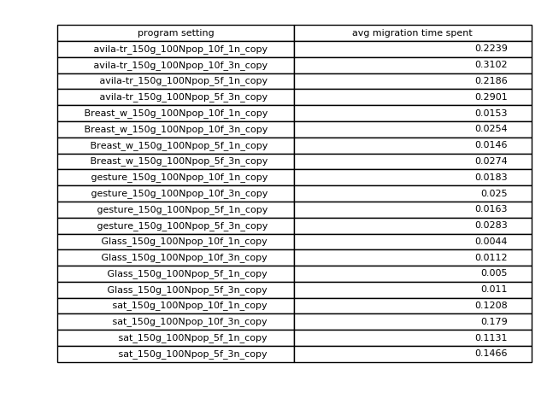
Migration time statistic

Slide 22
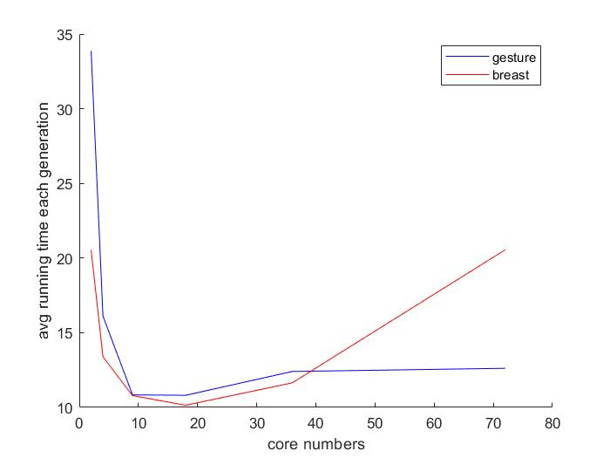
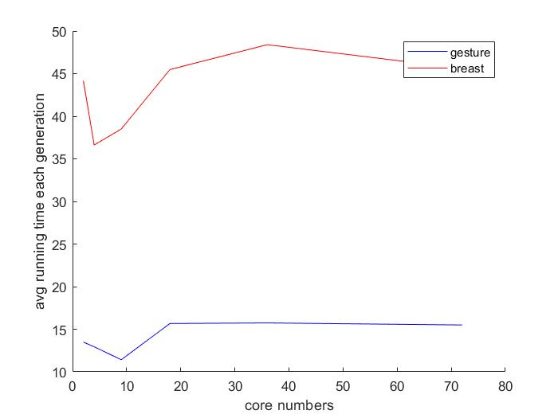
Each generation time in different number of Cores
Master-slave
Ring
The processes’ communication time can be overhead respecting to cores’ number
For different dataset the best cores’ number is different

Slide 23
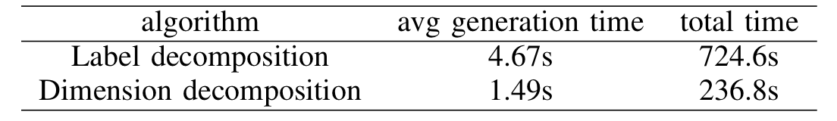
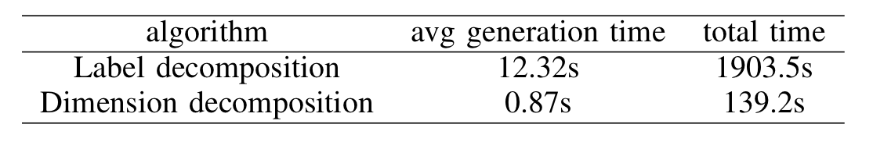
Decomposition algorithm
Label decomposition: each subpopulation size is 30, run 150 generations.
Dimensional decomposition: each subpopulation size is 100, run 150 generations.
Glass_table
wine_change_table

Slide 24
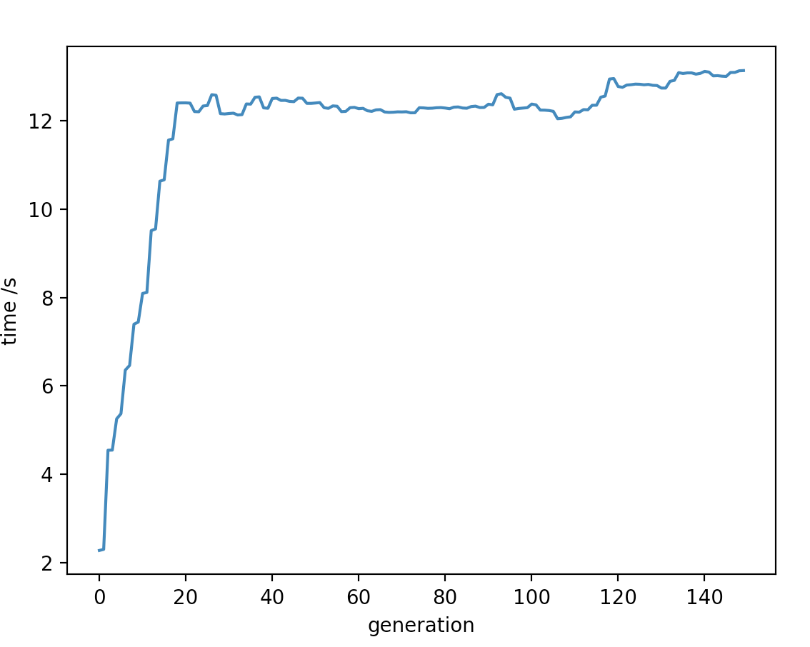
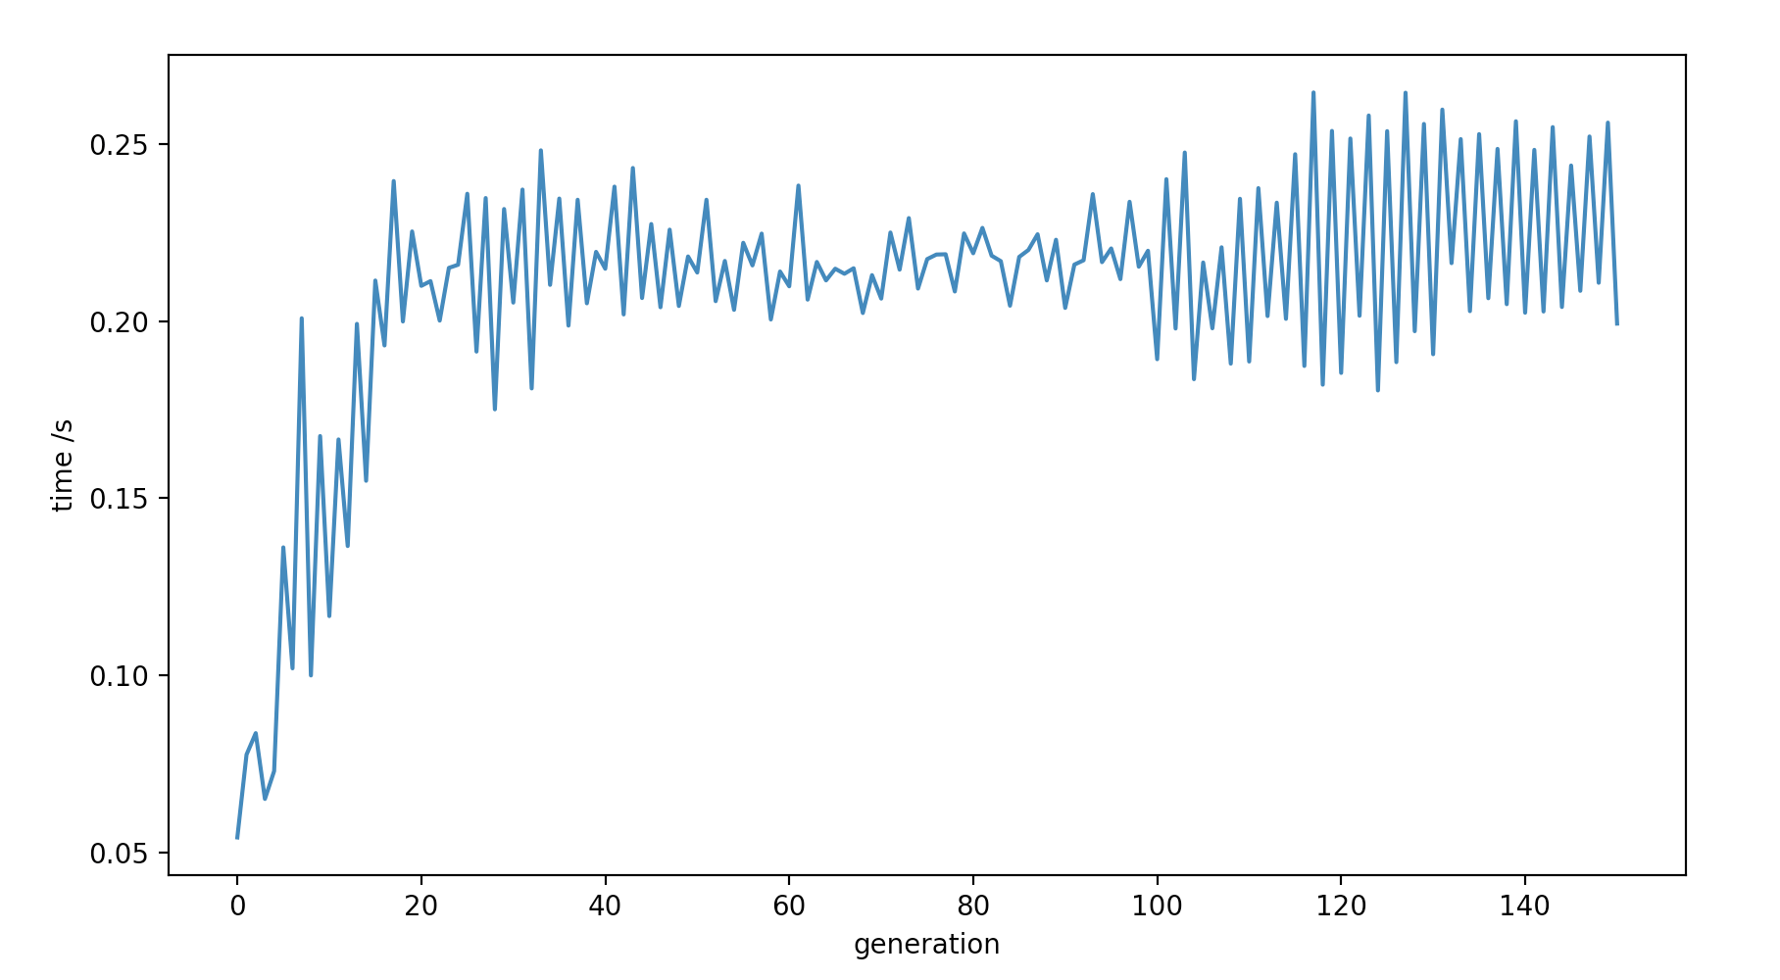
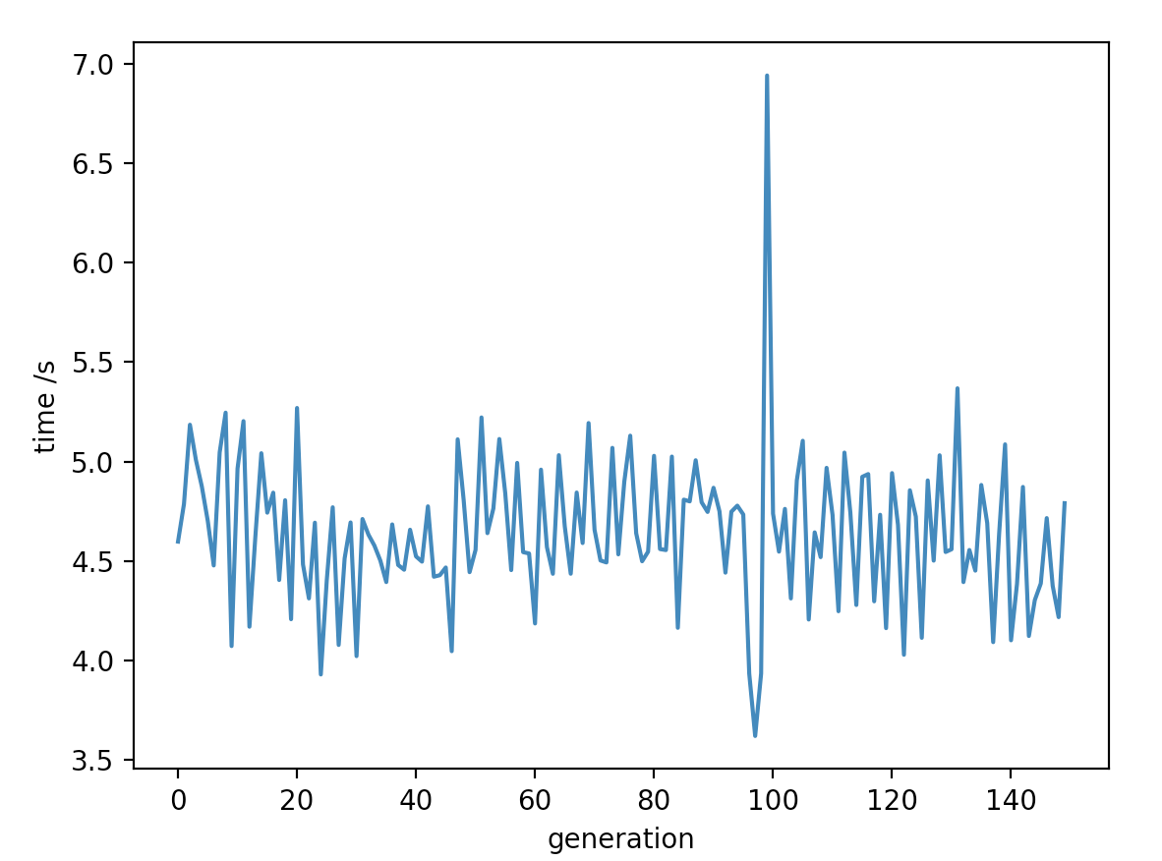
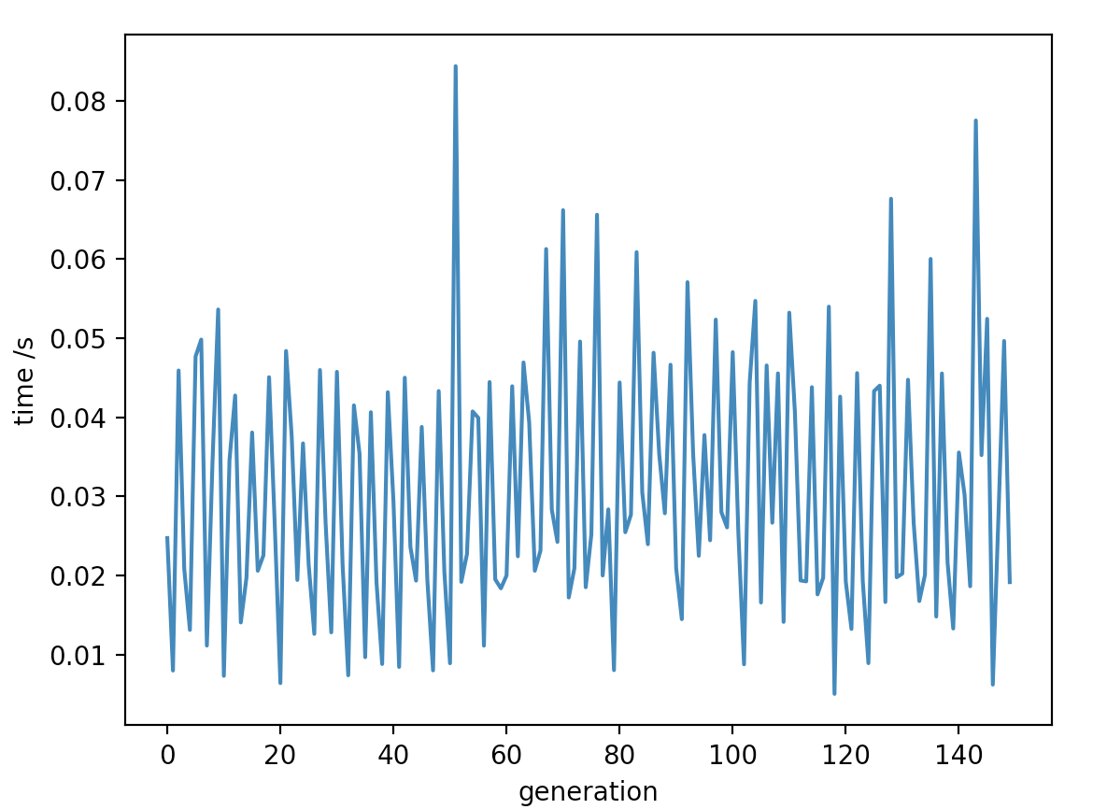
Label Decomposition
wine_change_generation_time
wine_change_communication_time
Glass_generation_time
Glass_communication_time

Slide 25
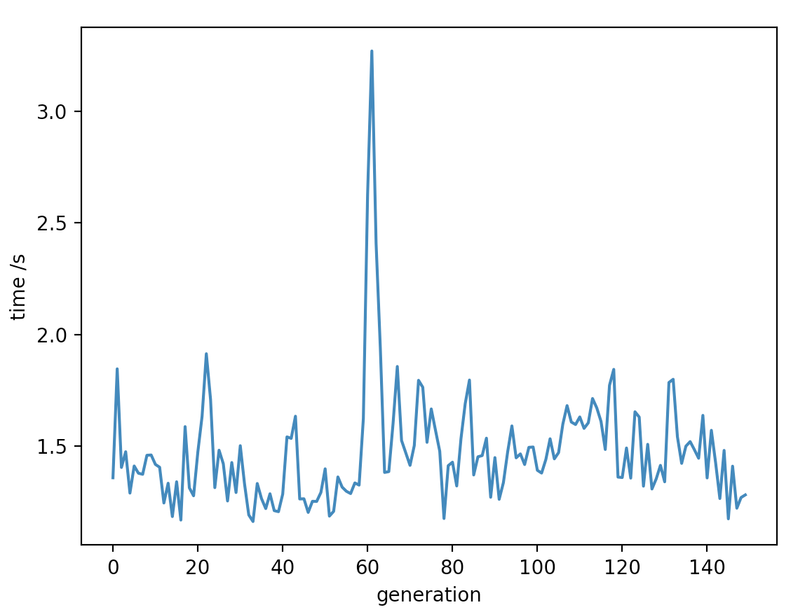
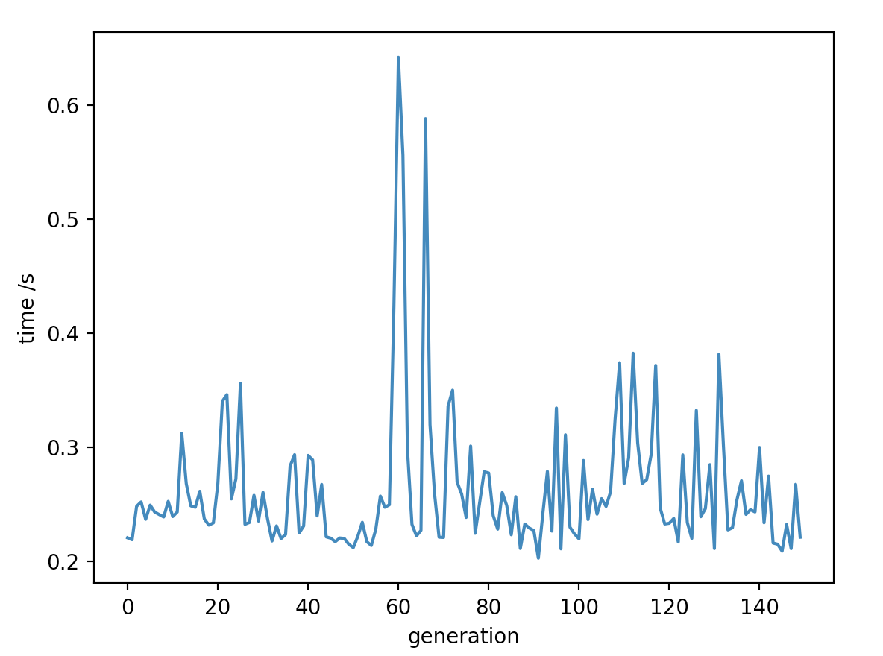
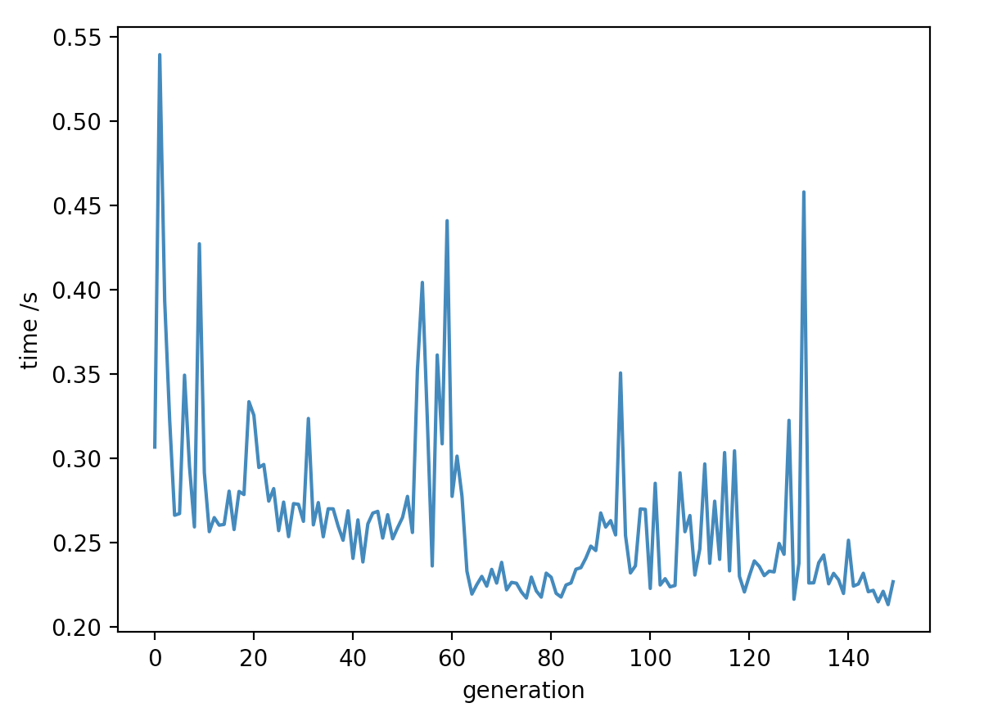
Dimension Decomposition
wine_change_generation_time
wine_change_communication_time
Glass_generation_time
Glass_communication_time

Slide 26
Analysis of experimental results and hypothesis
Analysis
1. label decomposition cost more time than dimension decomposition
2. Compared to the wine_change dataset and the glass dataset, the label decomposition takes less time and the dimension decomposition takes more time.
hypothesis
For label decomposition, the algorithm run faster in the multi-label dataset than in the small-label dataset when those datasets size and dimension are equal.

